Slide 3
MARK YOUR CALENDAR FOR IMPORTANT SUMMER DATES:
JUNE 1-8: Puerto Rico Mission Trip
JUNE 17-21: WinShape Camp
JULY 15-19: FUSION
JULY 22-26: VBS

Slide 4
Prayer for Puerto Rico Missions Trip

Slide 9
http://nrbc.org
Download the bulletin and sermon notes…
“Current Date”

Slide 10
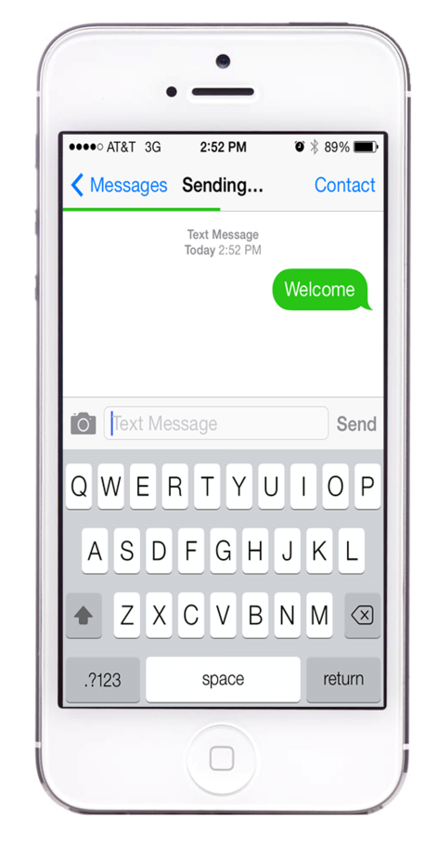
Text “Welcome” to 540-999-1889

Slide 11
*Meals Resume January 9, 2019

Slide 12
Welcome to North Roanoke and thank you for worshipping with us today! If you are a guest, we want you to feel welcome and know how grateful we are that God has sent you here. If we can serve you in any way, please don’t hesitate to ask an usher or anyone seated nearby – we are eager to help.

Slide 15
Notes:
Rotate a different cell phone slide each week

Slide 16
Notes:
Rotate a different cell phone slide each week

Slide 17
Notes:
Rotate a different cell phone slide each week

Slide 18
Notes:
Rotate a different cell phone slide each week

Slide 19
Notes:
Rotate a different cell phone slide each week

Slide 20
Notes:
Rotate a different cell phone slide each week

Slide 21
Notes:
Rotate a different cell phone slide each week

Slide 22
Notes:
Rotate a different cell phone slide each week

Slide 23
Notes:
Rotate a different cell phone slide each week

Slide 24
Notes:
Rotate a different cell phone slide each week

Slide 25
Notes:
Rotate a different cell phone slide each week

Slide 26
Notes:
Rotate a different cell phone slide each week

Slide 27
Notes:
Rotate a different cell phone slide each week

Slide 28
Notes:
Rotate a different cell phone slide each week

Slide 29
Notes:
Rotate a different cell phone slide each week

Slide 30
Notes:
Rotate a different cell phone slide each week

Slide 31
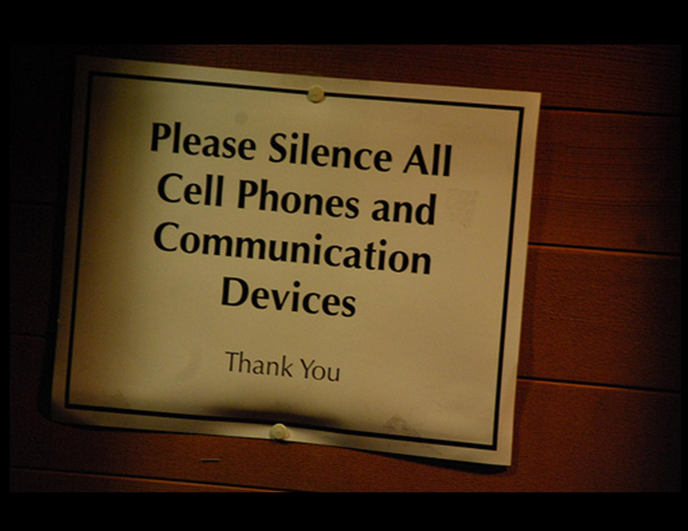
Notes:
Rotate a different cell phone slide each week

Slide 32
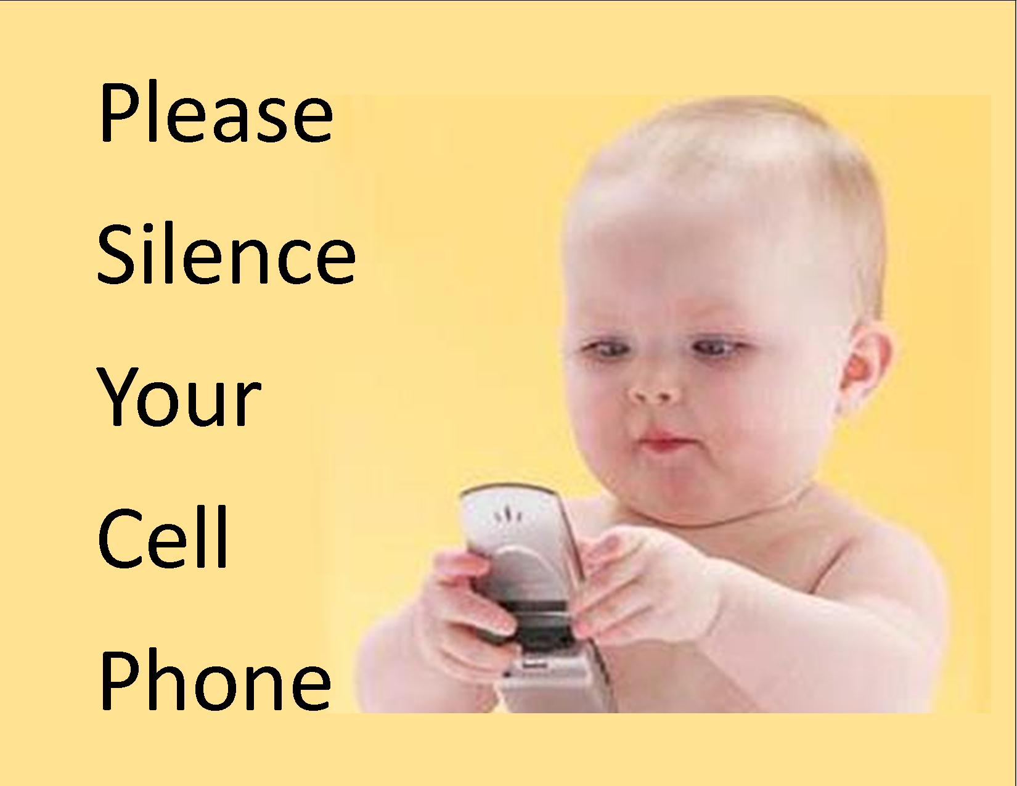
Notes:
Rotate a different cell phone slide each week

